Slide 1
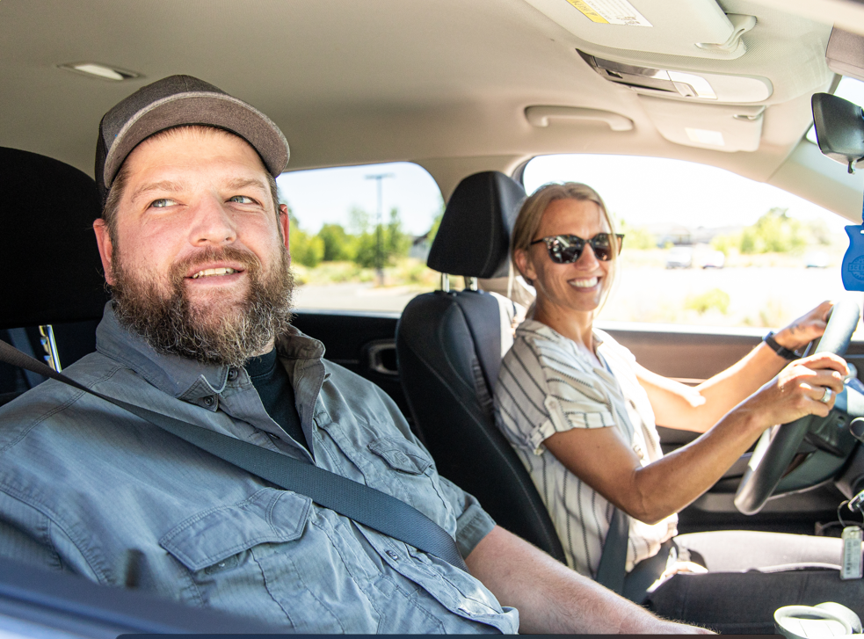


Make Your Commute Better!
Discover the benefits
of commute options
Save money
Boost your health
Reduce CO
Enjoy the ride
2
Visit GetThereOregon.org

Slide 2
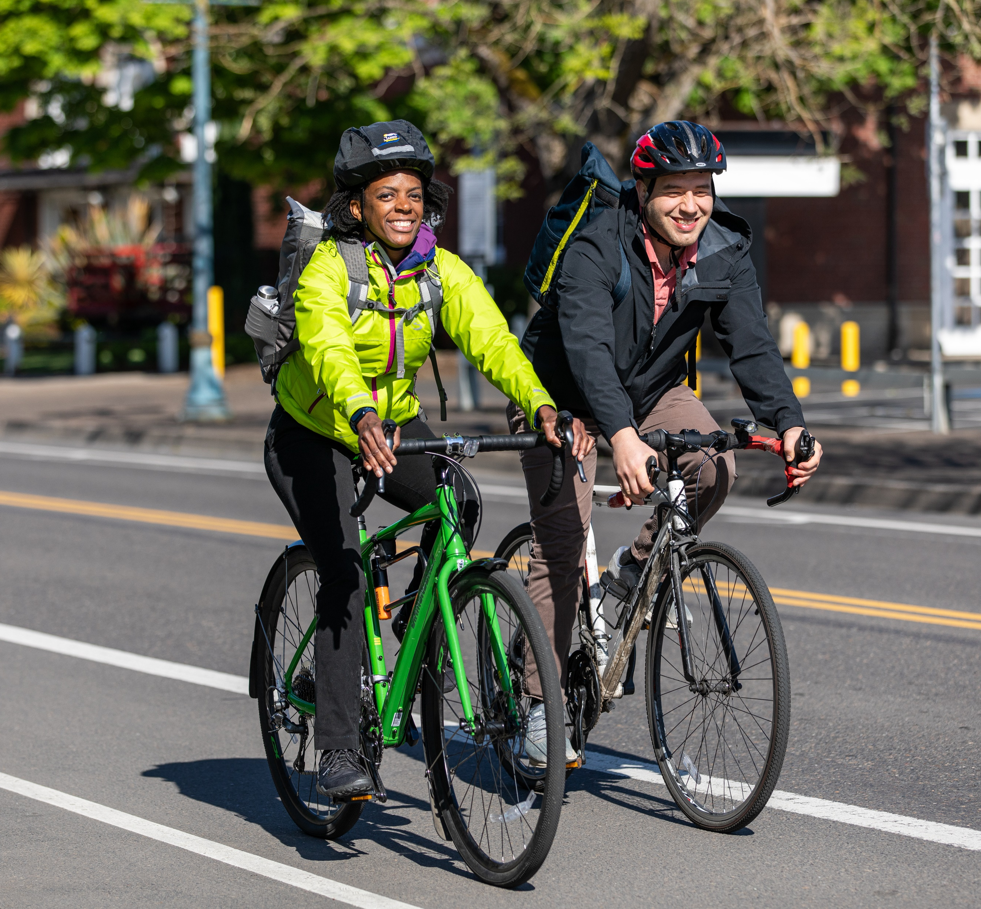
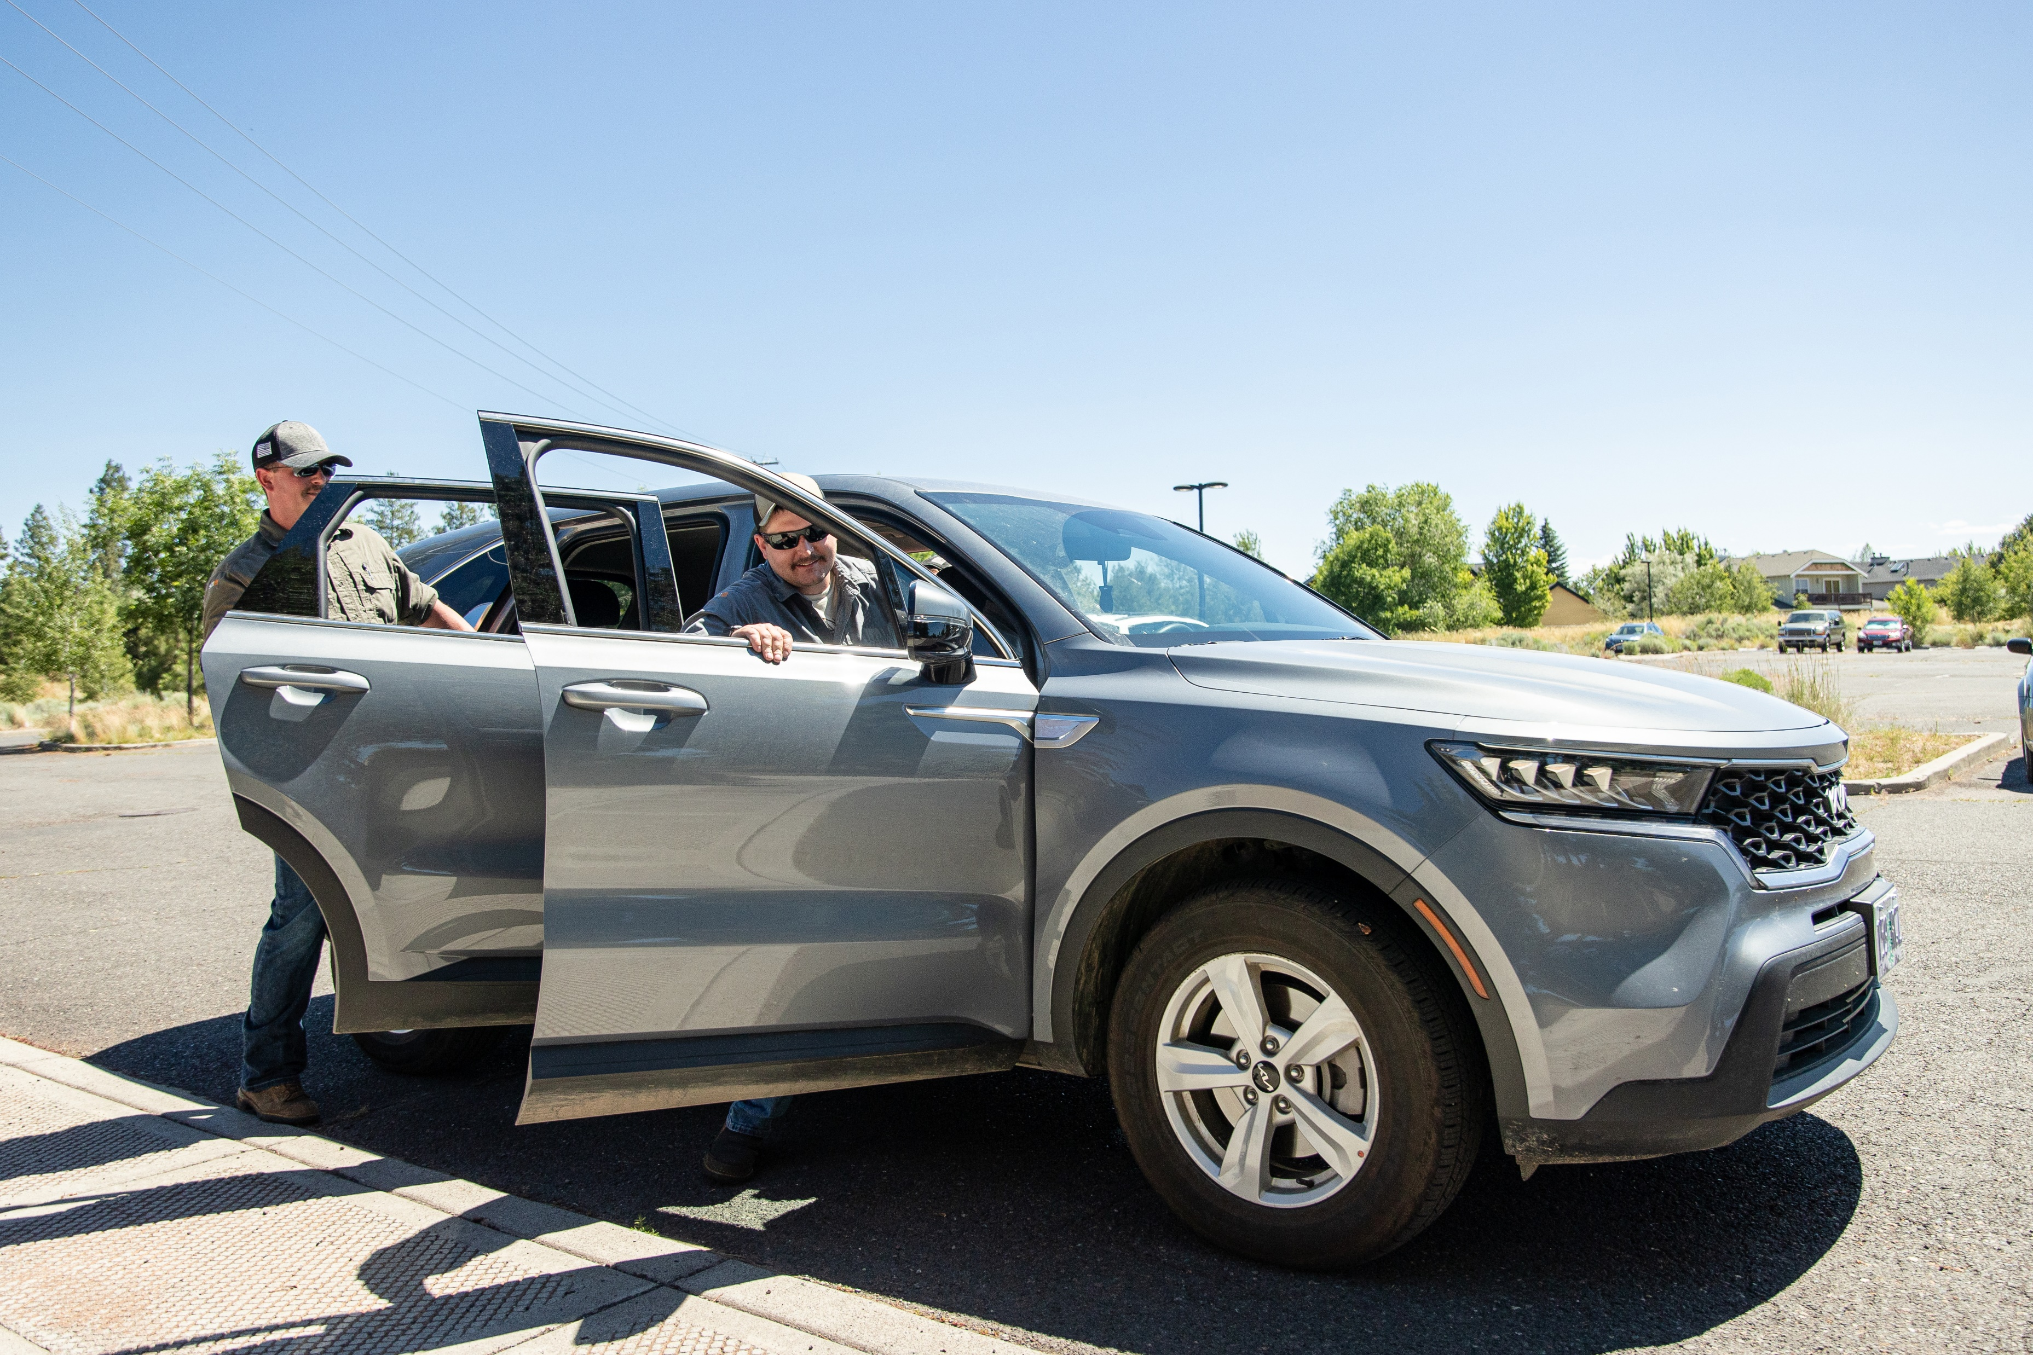
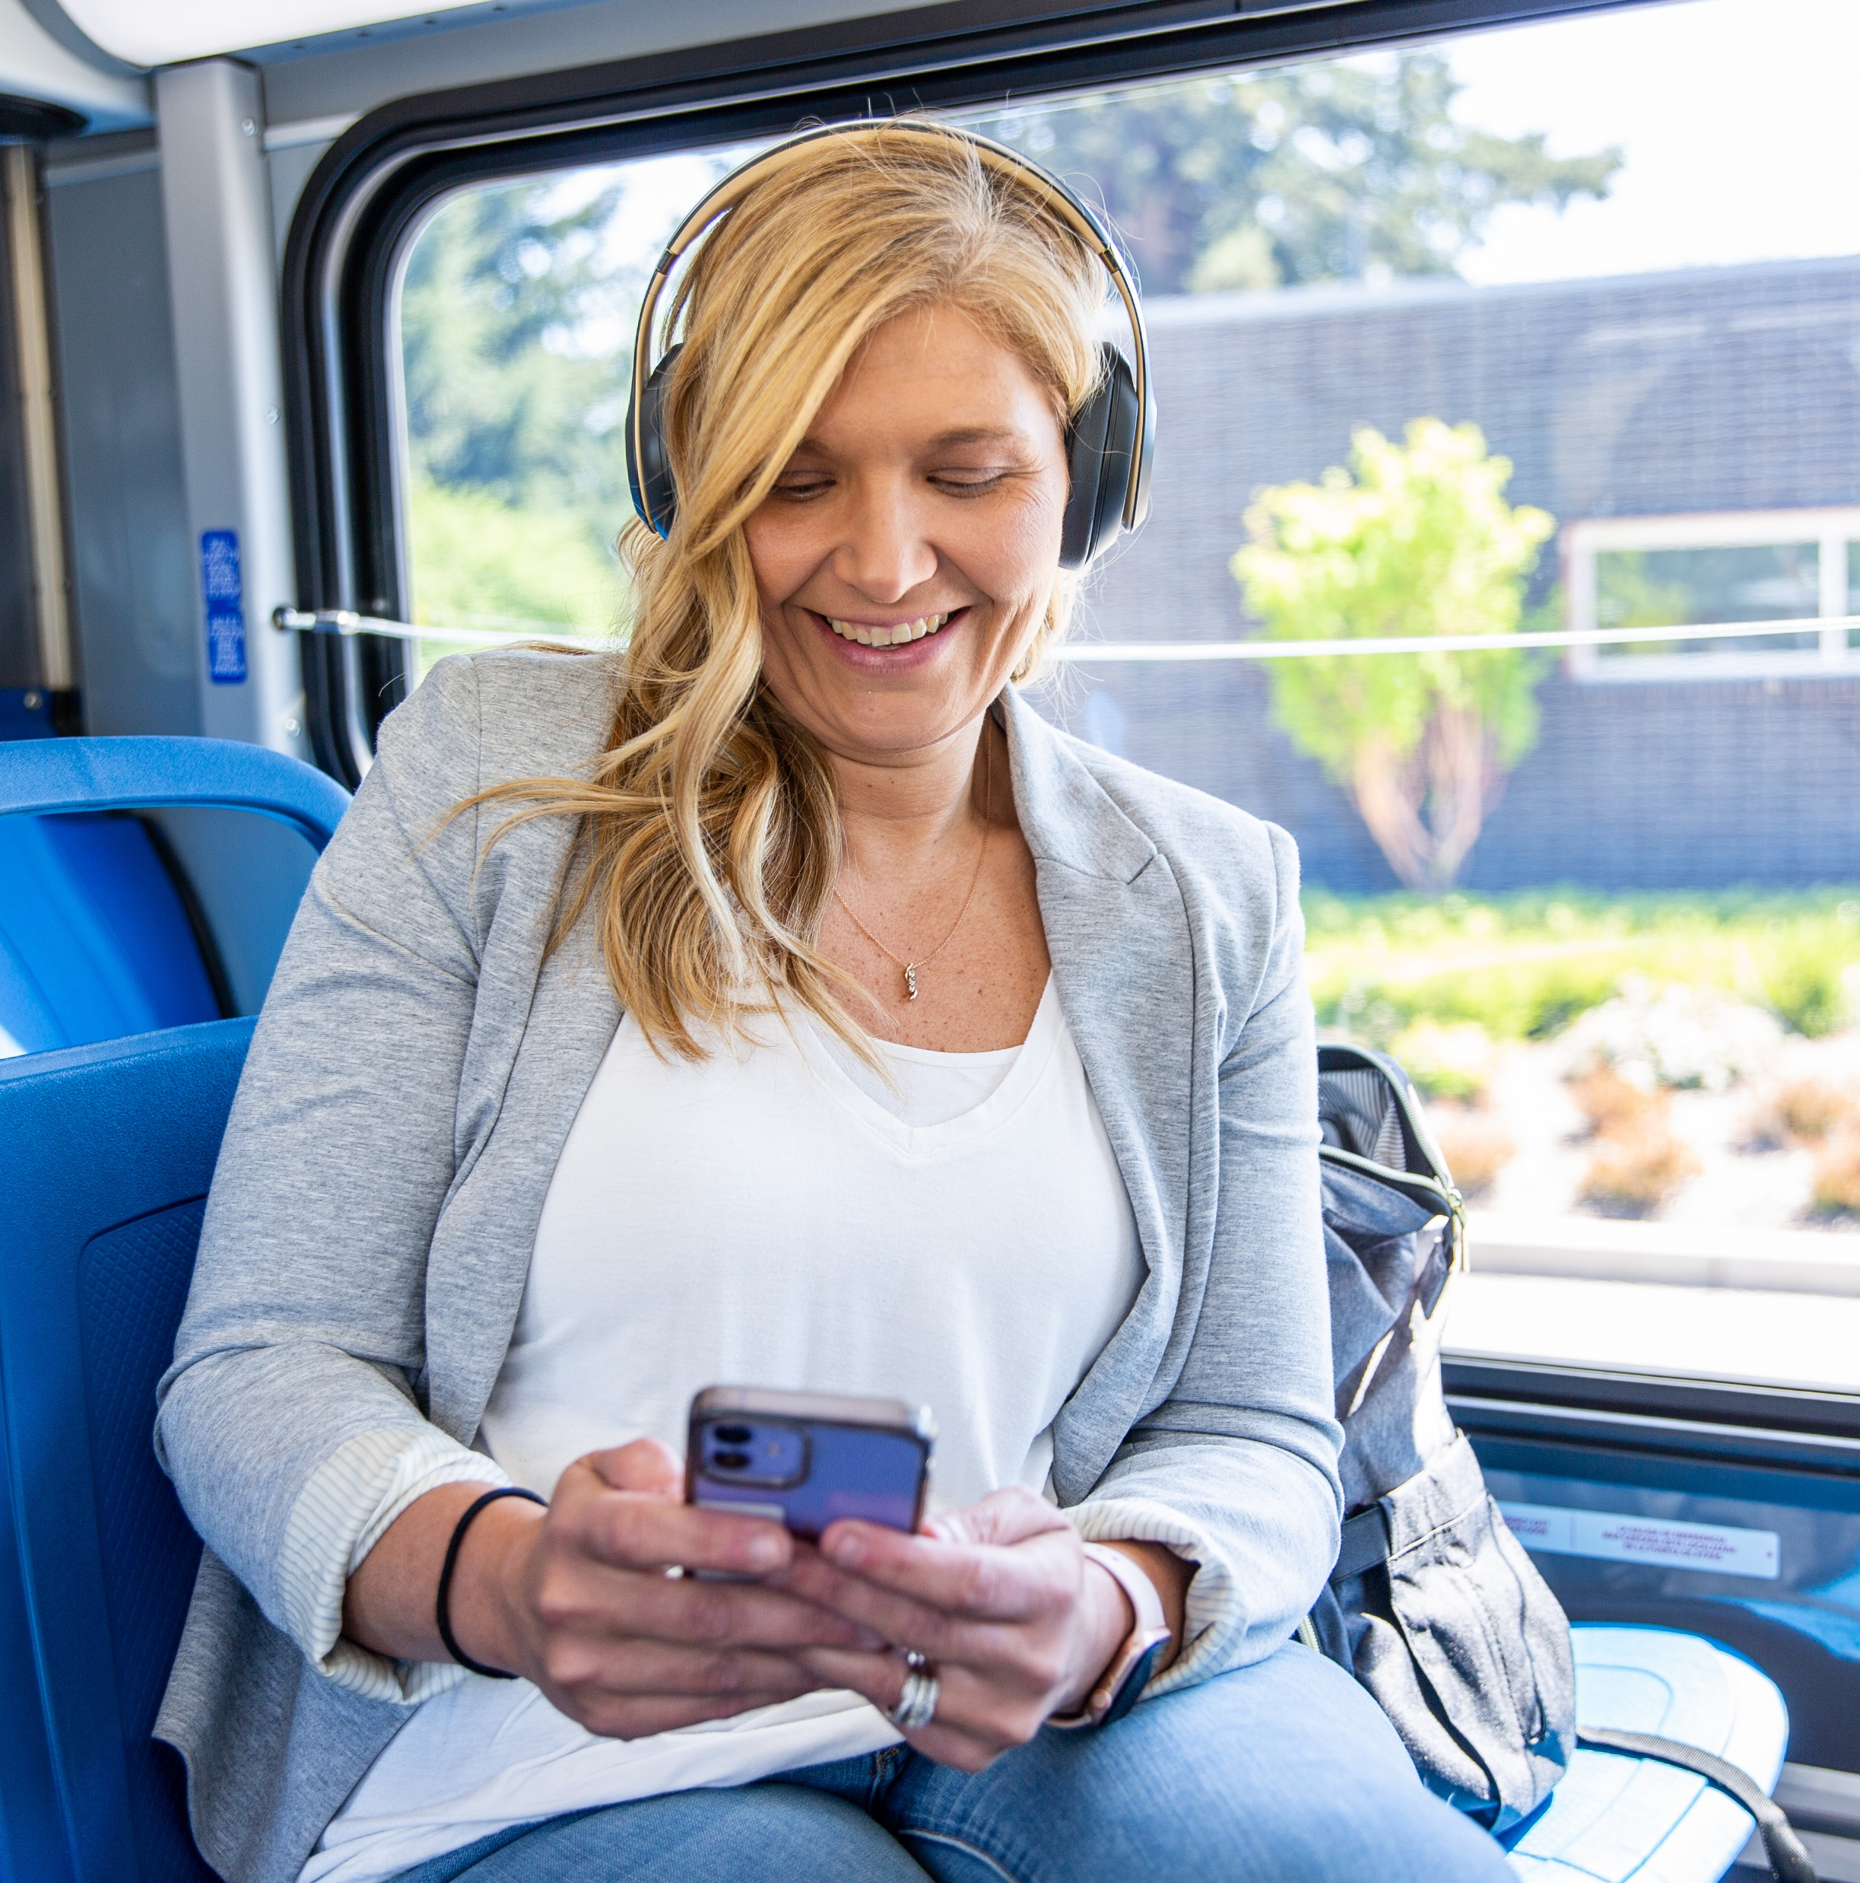
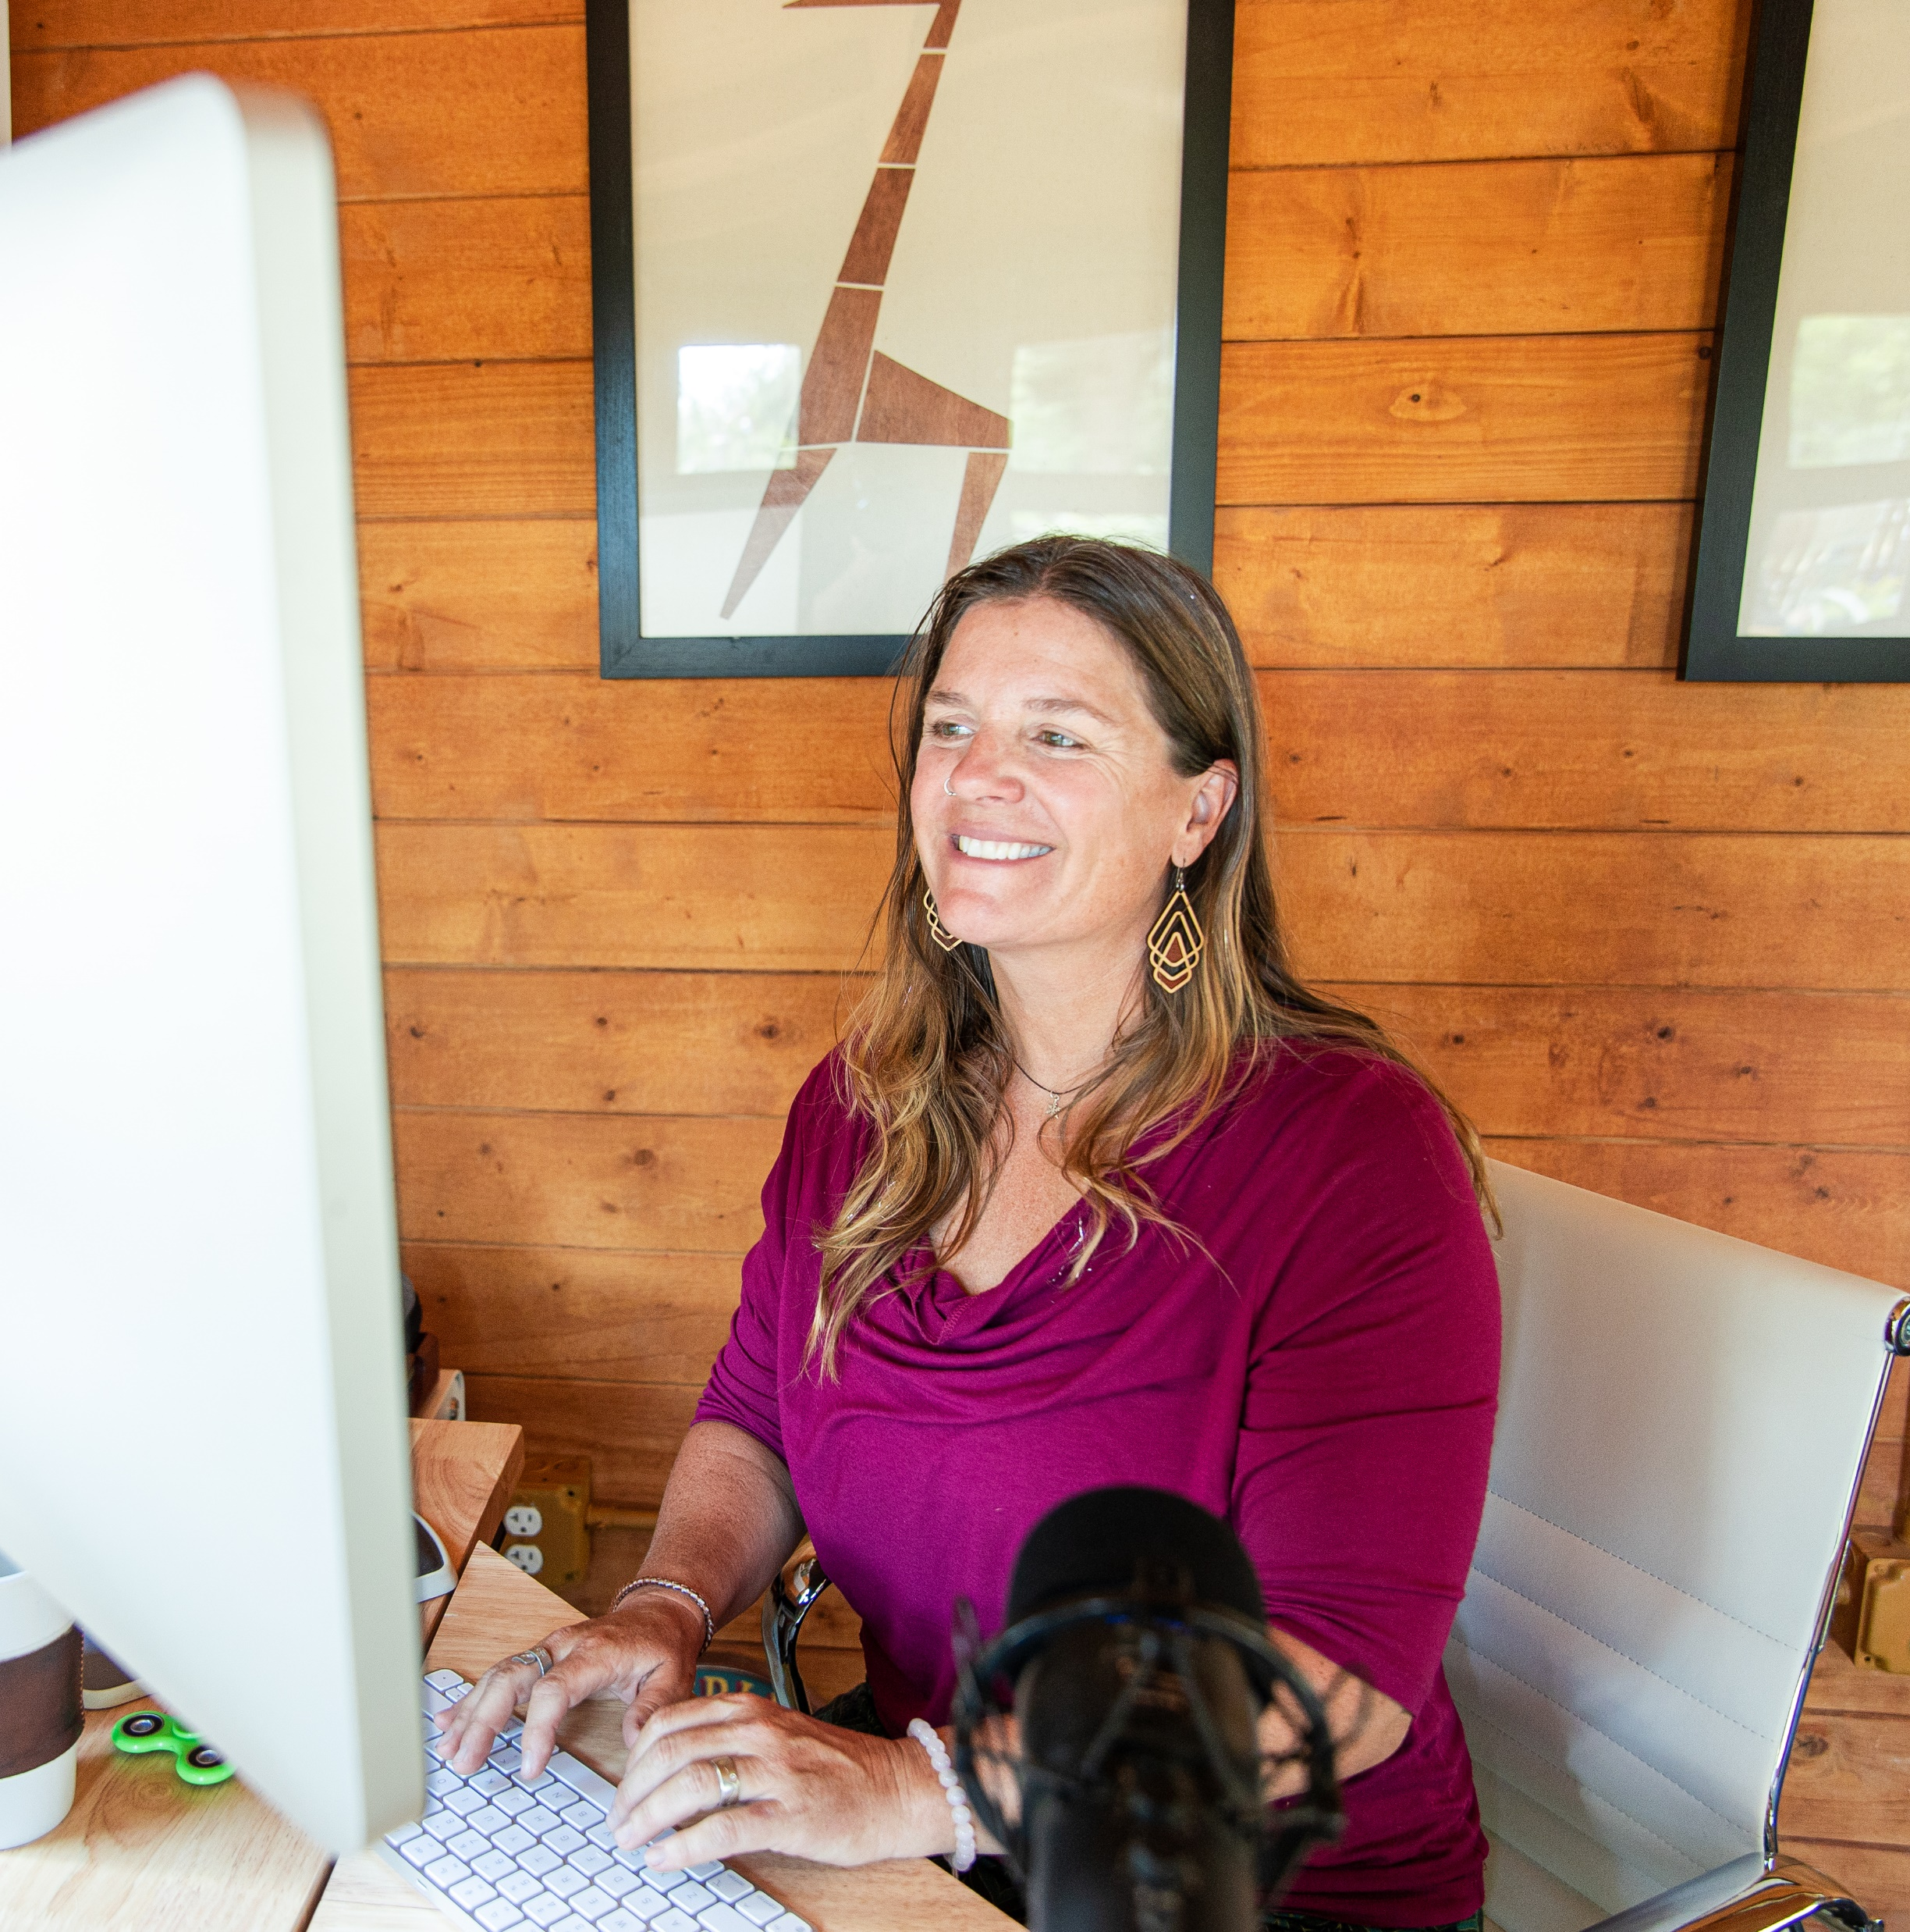
Explore Your Commute Options!
Carpool
Vanpool
Bike
Transit
Remote work
Compressed work
Visit GetThereOregon.org

Slide 3
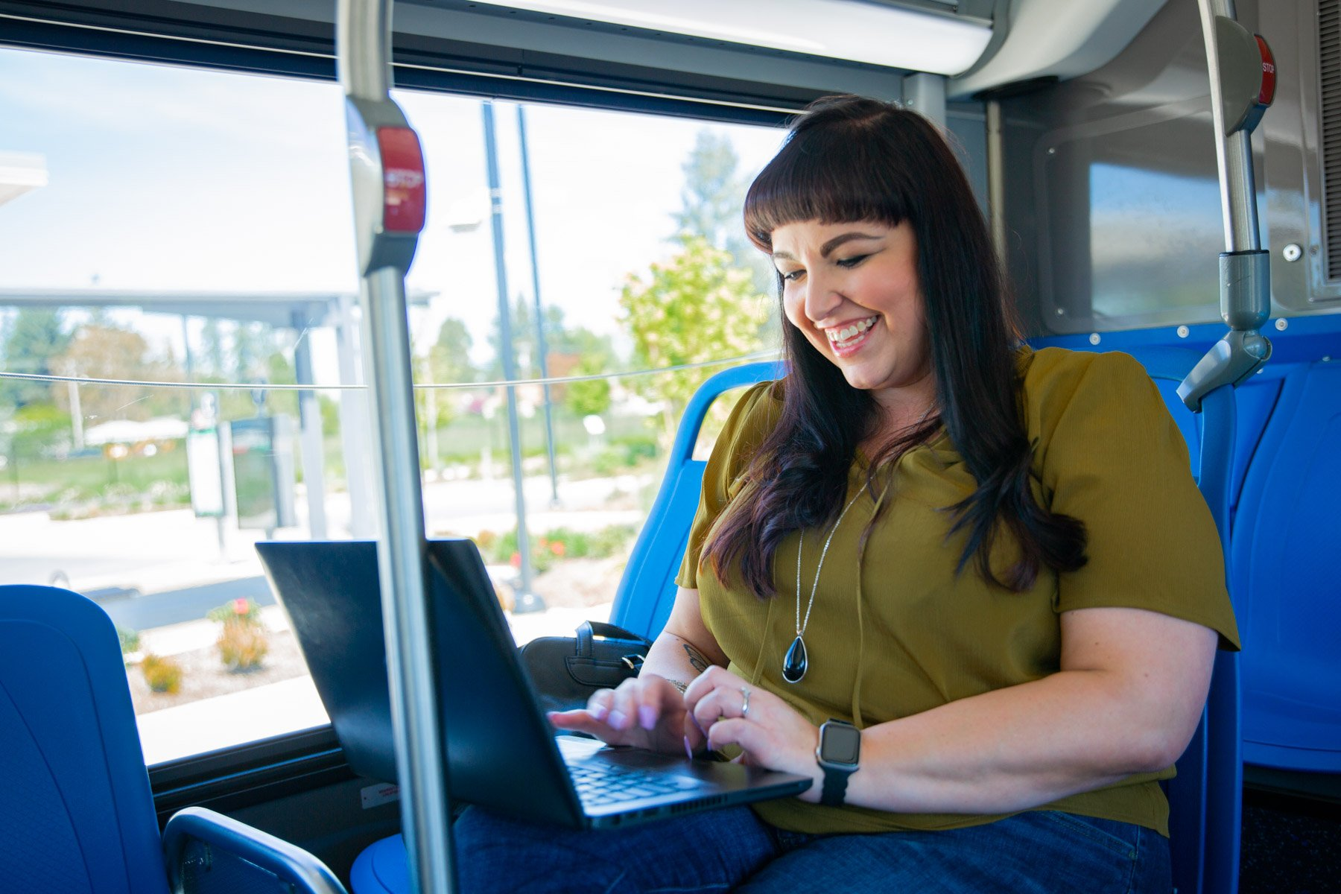
Use Get There Connect to:
Find commute options
Join or start a carpool or vanpool
Enter challenges + earn rewards
Track savings, CO ,+ more!
2
Visit GetThereOregon.org

Slide 4
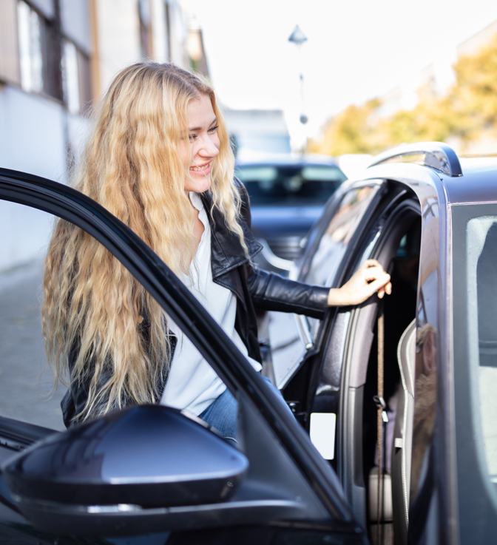
Carpooling made easy!
Sign up or log in to Get There Connect at GetThereOregon.org
Go to your Dashboard and enter your commute details in the “My Trips” box
  Be sure to check the “Carpool” box and specify if you want to be a driver only, passenger only, or either
Click “Save” and see available carpool options
  To join an available carpool, click on the person’s name and click “Connect” to send them a message

